Slide 1

Title
Your Name, Academic Advisor name, Industry advisor name
24 APR 2020
Thesis or Project?
Submitted in partial fulfillment of the requirement for the degree of
Master of Science in Electrical and Computer Engineering
Electrical and Computer Engineering (ECE)
Electrical and Computer Engineering (ECE)

Slide 2
Overview
Make sure you include the following:
  Background
    Why is this project interesting?
  Existing work – with citation
  Purpose or the project
  Setup
    How do you achieve the project (hardware, software)
  Results
    How did you achieve the results – explain
    What are the results – clearly show
    Conclusion of the results
    How are your results different from other researchers?
  Final contributions
    What are the contributions of this project?
  Your publications and grants related to this project
  Future works
    What can be added to this project
  References
    Follow IEEE format
  Acknowledgments
Electrical and Computer Engineering (ECE)

Slide 3
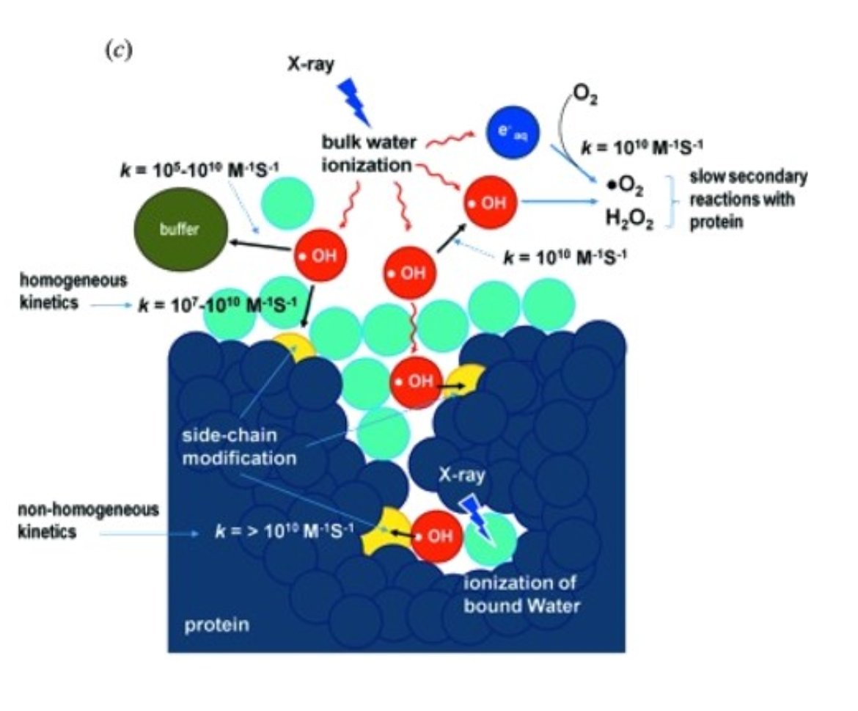
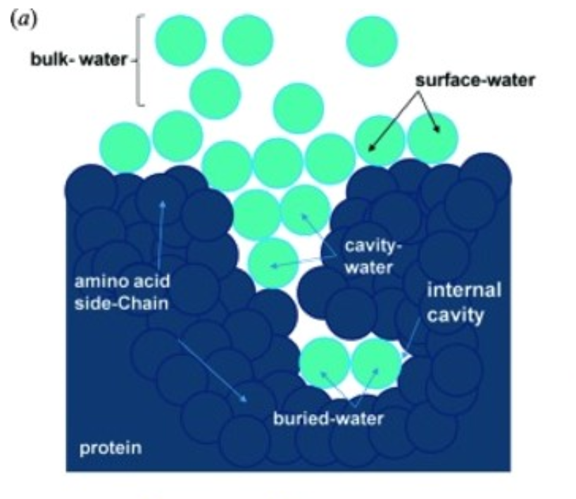
Background
Background
Credit: Synchrotron X-ray footprinting as a method to visualize water in proteins, Gupta et. al., 2016

Slide 4
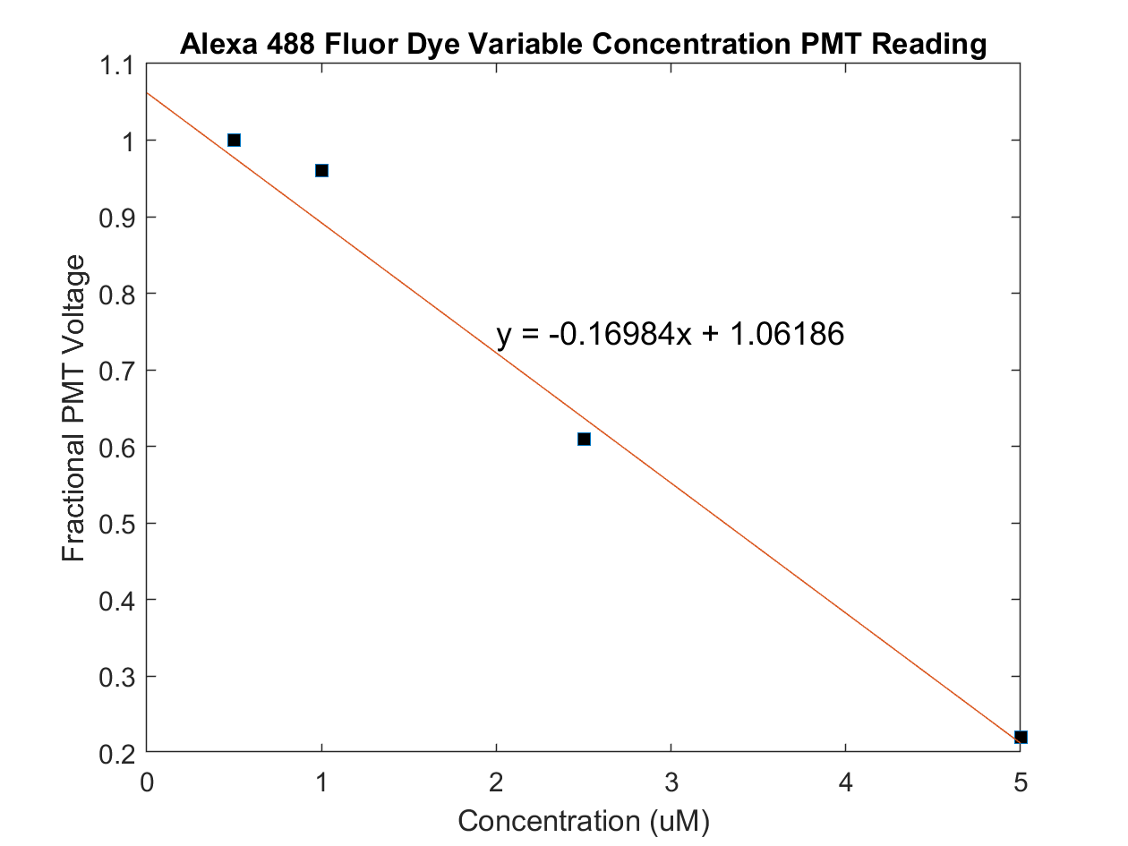
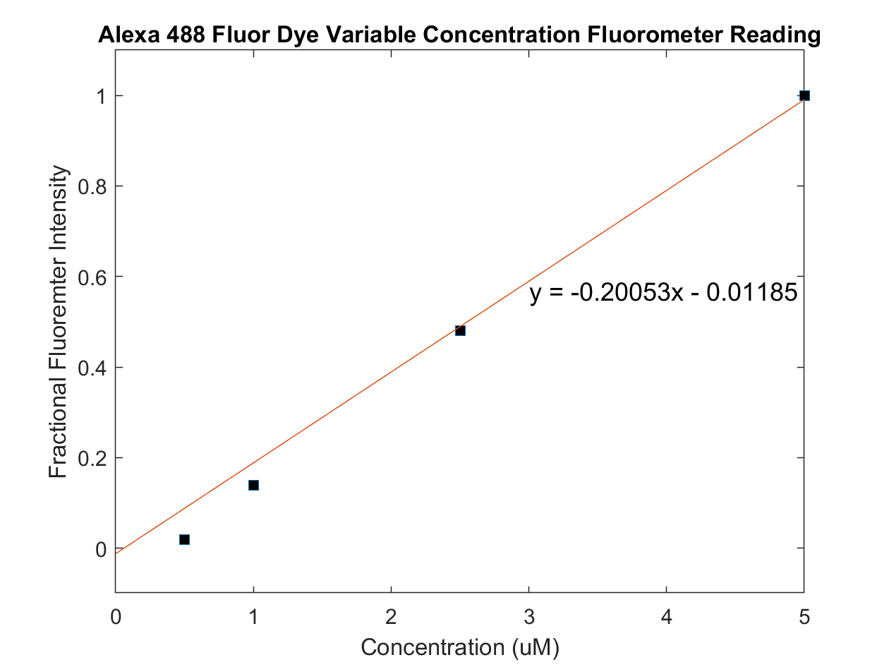
Results
PMT vs Fluorometer comparison:
Regression models indicate that a difference of < 4 x 10⁻² is achieved when comparing PMT and fluorometer measurements.
Electrical and Computer Engineering (ECE)

Slide 5
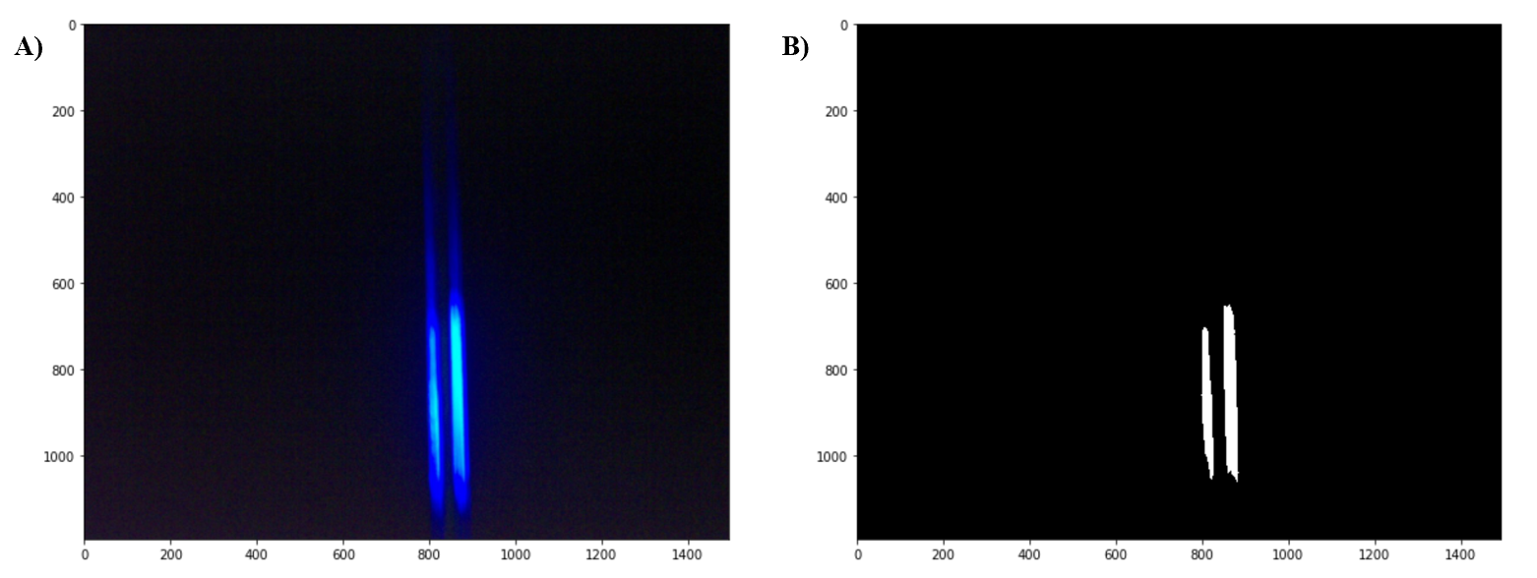
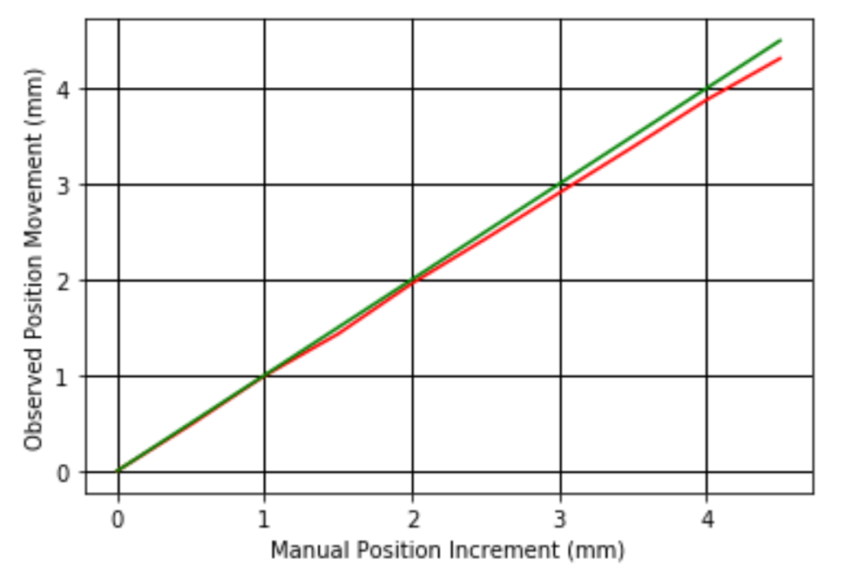
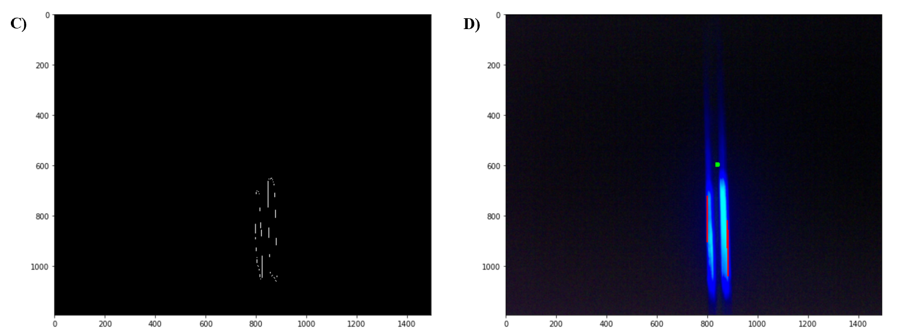
Jet Center
Original jet image
Threshold image
Canny edge algorithm
Probabilistic Hough Transform
Linear regression results in 170 um error. Manual micrometer the source?
Notes:
Canny: Gaussian noise reduction (5x4), 3x3 sobel operators, non maximum suppression, hysteresis thresholding

Slide 6
Contributions
The main contributions of this work includes:
The design of an accurate automated interface allowing for a minimum dose exposure of 2 µs, not previously achieved in XF, with minimum sample delivery of 25 µl.
An automated technique to ensure precision alignment of the liquid jet and the X-ray within 170 microns.
These contributions yield a 50-fold reduction in experimental time, while minimizing sample volume ~ 10-fold, drastically reducing the resources needed to conduct the experiment.
Electrical and Computer Engineering (ECE)

Slide 7
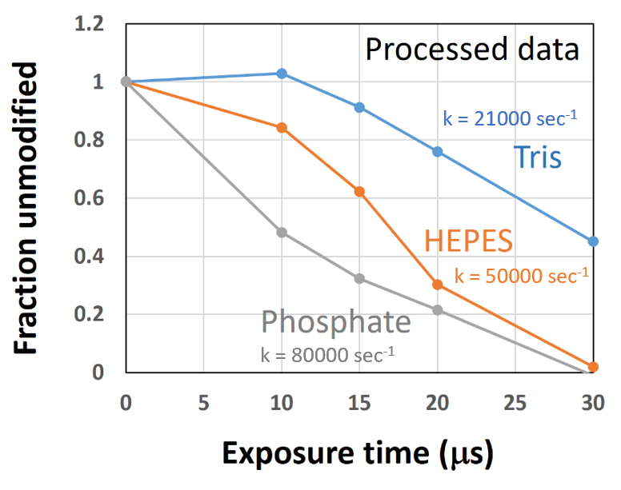
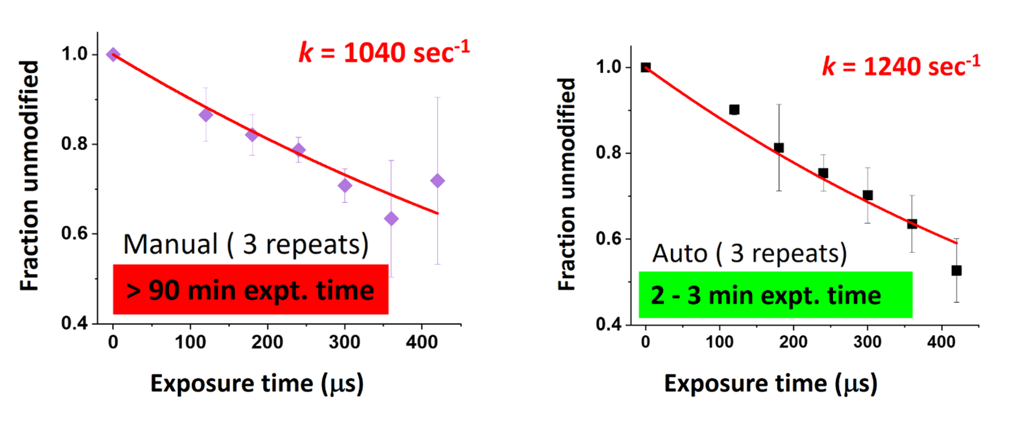
Achievements
NSLS-II: Scavenging effects reduced in HEPES/Tris. This is a significant achievement due to the need for many proteins to be processed in these buffers.
ALS: Data analysis removing jet imaging anomaly and results in more accurate results.
Electrical and Computer Engineering (ECE)
Images credit: Dr. Sayan Gupta
Notes:
HEPES: sulfonic acid buffering agent, Tris: 2-Amino-2-(hydroxymethyl)propane-1,3-dio

Slide 8
Acknowledgements
Advisor: Dr. Farid Farahmand
Mentors/Industry Advisors:
Dr. Sayan Gupta & Dr. Corie Ralston
Teammate: Brandon Russell
Committee: Dr. Mohammed Salem & Dr. Sudhir Shrestha
Lawrence Berkeley Laboratory, ALS
Electrical and Computer Engineering (ECE)

Slide 9
References
1. Galas, D., & Schmitz, A. (1978). DNAase footprinting: a simple method for the detection of protein-DNA binding specificity. Nucleic Acids Research, 5(9), 3157-3170.
2. Tullius, T., & Dombroski, B. (1986). Hydroxyl radical "footprinting": High-resolution information about DNA-protein contacts and application to X repressor and Cro protein. Proc. Natl. Acad. Sci. USA, 83, 5469-5473.
3. Sclavi, B., Woodson, S., Sullivan, M., Chance, M., & Brenowitz, M. (1998). Following the folding of RNA with time-resolved synchrotron X-ray footprinting. Methods in Enzymology, 295, 379-402.
4. Maleknia, S., Brenowitz, M., & Chance, M. (1999). Millisecond radiolytic modification of peptides by synchrotron X-rays identified by mass spectrometry. Analytical Chemistry, 15(71), 3965-3973.
5. Gupta, S., Sullivan, M., Toomey, J., Kiselar, J., & Chance, M. (2007). The Beamline X28C of the Center for Synchrotron Biosciences: a national resource for biomolecular structure and dynamics experiments using synchrotron footprinting. Journal of Synchrotron Radiation, 14(Pt 3), 233-243.
6. Gupta, S., Celestre, R., Petzold, C., Chance, M., & Ralston, C. (2014). Development of a microsecond X-ray footprinting facility at the Advanced Light Source. Journal of Synchrotron Radiation, 21(4), 690-699.
7. Morton, S., Gupta, S., Petzold, C., & Ralston, C*. (2019). Recent Advances in X-Ray Hydroxyl Radical Footprinting at the Advanced Light Source Synchrotron. Protein & Peptide Letters, 26(1).
8. Gupta, S., Chen, Y., Petzold, C., DePonte, D., & Ralston, C. (2019). Development of Container Free Sample Exposure for Synchrotron X-ray Footprinting. Analytical Chemistry, 92(1), 1565-1573.
9. 17-BM “XFP”, National Synchrotron Light Source II, Brookhaven National Laboratory. (n.d.). Retrieved from https://www.bnl.gov/ps/beamlines/beamline. php?r=17-BM
10. Beamline 3.2.1, Advanced Light Source, Berkeley Lab. (n.d.). Retrieved from https://als.lbl.gov/beamlines/3-2-1/
11. Garg, B., & Sharma, G.K. (2016). A quality-aware Energy-scalable Gaussian Smoothing Filter for image processing applications. Microprocessors and Microsystems, 45(A), 1-9.
12. Khan, Y., Ahmed, F., & Khan S. (2013). Situation recognition using image moments and recurrent neural networks. Neural Computing and Applications, 24, 1519-1529.
13. Belkasim S.O., Shridhar M., & Ahmadi M. (1991). Pattern recognition with moment invariants. A comparative study and new Results. Pattern Recognition 24(12):1117–1138
14. Dudani S.A., Breeding K.J., & McGhee R.B. (1977) Aircraft identification by moment invariants. IEEE Transactions on Computers, C-26(1):39–46
15. Canny Edge Detection. (2013). Retrieved from https://opencv-python-tutroals.readthedocs.io/en/latest/py_tutorials/py_imgproc/py_canny/py_canny.html
16. Sahir, S. (2019). Canny Edge Detection Step by Step in Python — Computer Vision. Retrieved from https://towardsdatascience.com/canny-edge-detection-step-by-step-in-python-computer-vision-b49c3a2d8123
17. Hough Line Transform. (2013). Retrieved from https://opencv-python-tutroals.readthedocs.io/en/latest/py_tutorials/py_imgproc/py_houghlines/py_houghlines.html#probabilistic-hough-transform
18. Gupta, S., Rosi, M., Russell, B., Costello, S., Chen, Y., Petzold, C., DePonte, D., Farahmand, F., & Ralston, C. (2020). Development of Automated Liquid-jet Sample Delivery for Single-digit Microsecond X-ray Radiolytic Labeling for Protein Structural Analysis. Unpublished manuscript.
Electrical and Computer Engineering (ECE)

Slide 10
Electrical and Computer Engineering (ECE)
Questions?

